Slide 1
Embedded Ethics: Dataset Bias in Image Understanding
Notes:
Licensed by the University of Toronto Embedded Ethics Education Initiative, Lindsey Shorser, Jonathan Calver and Paul Gries under the Attribution-NonCommercial-ShareAlike 4.0 International license. To view a copy of this license, visit https://creativecommons.org/licenses/by-nc-sa/4.0/.
Photo by Vitaly Vlasov from Pexels (https://www.pexels.com/photo/person-pointing-numeric-print-1342460/)
Photo by Charl Durand from Pexels (https://www.pexels.com/photo/the-thinker-statue-in-rodin-museum-france-6486112/)

Slide 2
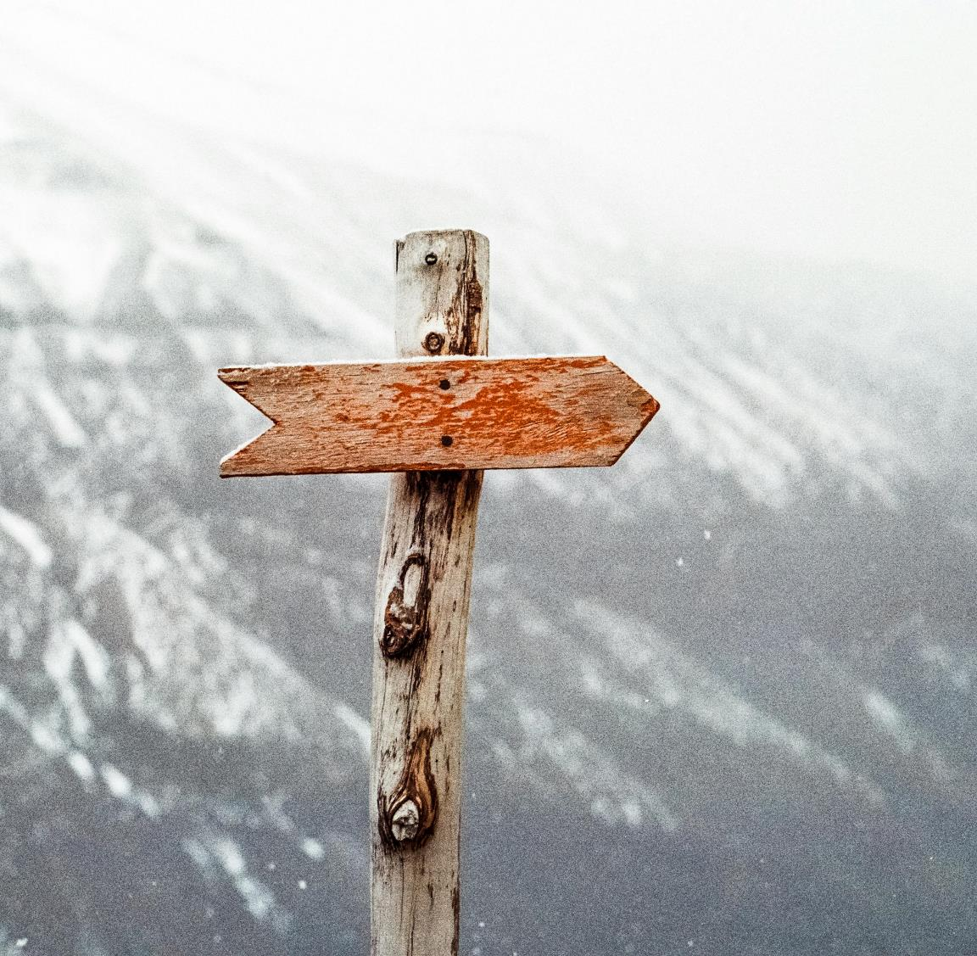
Part 1:
Warm-up Activity
Notes:
Photo by Jens Johnsson: https://www.pexels.com/photo/brown-wooden-arrow-signed-66100/

Slide 3
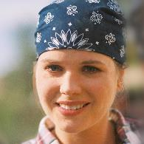
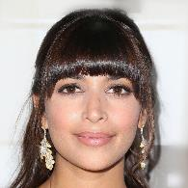
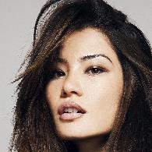
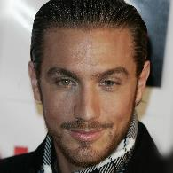
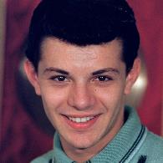
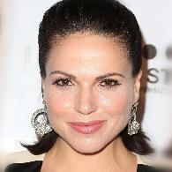
Samples from CelebA-HQ Dataset
Notes:
Computer science instructor should introduce Celeb-A dataset. Note that it is an unlabeled data set.

Slide 4
Small group discussions
What groups are not represented in this dataset?
Samples from CelebA-HQ Dataset
Notes:
Some sample answers: no children, not racially diverse, mostly young people, most women are wearing make-up..

Slide 5
Small group discussions
What groups are not represented in this dataset?
What is this dataset not useful for?
Samples from CelebA-HQ Dataset
Notes:
Sample answers:
1. All direct profiles – so can’t use it to train 3d images, generate side profiles
2. Eyes are all looking at the camera
3. Can’t predict age groups well (because lack of elderly people), likely to misfire on non-white people

Slide 6
Small group discussions
What groups are not represented in this dataset?
What is this dataset not useful for?
What is this dataset useful for?
Samples from CelebA-HQ Dataset
Notes:
Consider framing the question in this way: “if your research supervisor gave you this dataset and asked you to do something with it?”
One answer: producing deepfakes of celebrities

Slide 7
Image stylization with CelebA-HQ
source images
Insert image from page 5 of: [Choi et al. ’20, “StarGAN v2: Diverse Image Synthesis for Multiple Domains”, available https://arxiv.org/pdf/1912.01865.pdf]
stylized images
Notes:
This demonstrates an attempt to render an image with the attributes found in the dataset– which attributes get transferred over? Generally it’s the attributes that are common among people in the dataset.

Slide 8
Projecting images onto CelebA-HQ models
Insert image from page 2 of [Esser, Rombach, Ommer. ’20, “A Note on Data Biases in Generative Models”], available: https://arxiv.org/pdf/2012.02516.pdf
Notes:
Higher resolution version of the dataset. You take an input image and try to project the input images onto what the model can generate. Each image inherits attributes or biases from the data. Another example is DALL-E – it has certain biases in how it creates images. For example, it’s almost impossible to make DALL-E make an image of a “nerd” without glasses, even if you prompt it explicitly to create an image without eyeglasses. And some of these biases are drawn from the image sets that it is trained on.
Image Source: https://github.com/CompVis/net2net

Slide 9
Part 2:
Bias in Datasets
Notes:
Photo by Jens Johnsson: https://www.pexels.com/photo/brown-wooden-arrow-signed-66100/

Slide 10
Object Recognition Dataset
Dataset bias is a known problem in object recognition datasets.
A. Torralba & A. Efros, CVPR 2011
Notes:
This is a seminal paper on dataset bias – the researchers looked at multiple standard datasets at the time for object recognition.

Slide 11
Object Recognition Dataset
Torralba & Efros, “Unbiased Look at Dataset Bias” (CVPR 2011)
Selection Bias
Capture Bias
Negative Set Bias
Insert image from page 2 of [Torralba & Efros, “Unbiased Look at Dataset Bias” (CVPR 2011)], available: https://people.csail.mit.edu/torralba/publications/datasets_cvpr11.pdf
- classifier to name the dataset of a random image from 12 datasets
- trained on 1000 image from each dataset
- accuracy: 39% (much better than random guess, 1/12 = 8%)
Notes:
Do you think, given a particular image, you could tell which dataset it was taken from? Probably!
How do you curate images? Could do it automatically or manually. Getting them manually increases risk of selection bias compared to automatic (even then, are they collected from the internet with specific keyword searches, are they collected only from certain countries, etc.)
Capture bias – how to photographers capture images?
Negative set bias- datasets only capture things that they are interested in, what about all the other object categories, subcategories, etc.

Slide 12
Object Recognition Dataset
Torralba & Efros (CVPR 2011)
Selection Bias
Capture Bias
Negative Set Bias
Label error bias
Some labels are wrong, but
what if the errors are not
random
Insert image from page 2 of [Torralba & Efros, “Unbiased Look at Dataset Bias” (CVPR 2011)], available: https://people.csail.mit.edu/torralba/publications/datasets_cvpr11.pdf
Notes:
Cars look very different in other datasets, plus there are other biases like label error bias, etc.

Slide 13
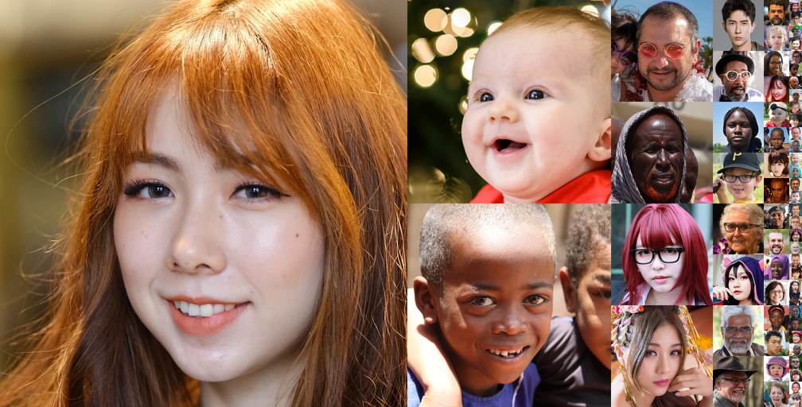
Example on faces
FFHQ dataset (70K images from Flickr)
Notes:
FFHQ dataset available here: https://github.com/NVlabs/ffhq-dataset
Followed up by another dataset called ffhq dataset (flickr faces high quality). This dataset has some statistics associated with it. But 85% are unknown still!
Images that are generated -> slight reduction in Black representation. Now you could intentionally rebalance it…

Slide 14
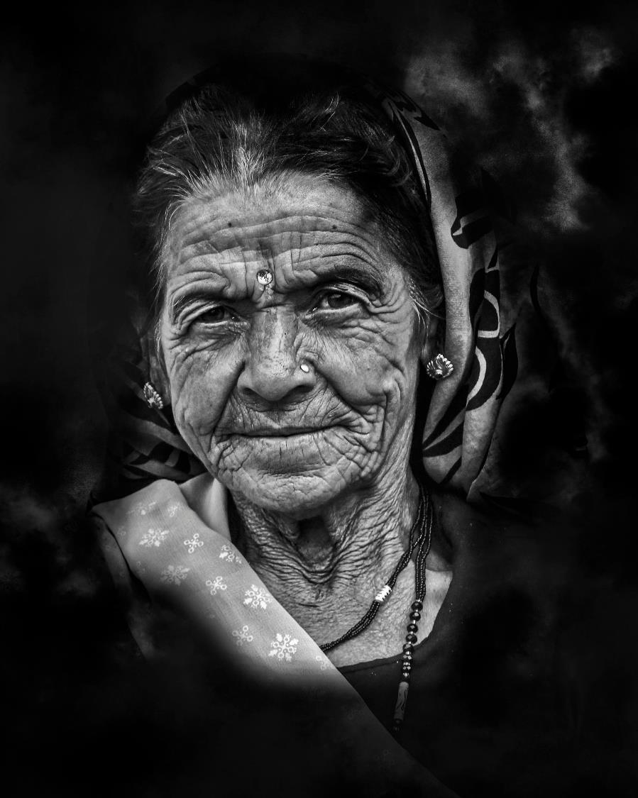
Real-life Example (Facial Analysis)
Pre-trained facial analysis models do not perform well when evaluated on faces of older adults with cognitive of physical disability

Slide 15
Dataset bias still a problem today!
very difficult to mitigate bias in large datasets
biases of such datasets not well explored/understood
model generalization is still an open research question
Notes:
Very difficult to mitigate / curate *giant* datasets (many datasets now consist of billions of images)

Slide 16
Part 3:
Mitigating Bias in Datasets
Notes:
Photo by Jens Johnsson: https://www.pexels.com/photo/brown-wooden-arrow-signed-66100/

Slide 17
Collect Better Datasets?
All datasets are finite attempts at sampling a distribution
Deep learning models used to obtain SOTA results on standard benchmarks are typically trained on hundreds of thousands to millions of training examples
It is not always practical to collect representative examples of this size from various populations to include in the training data

Slide 18
It’s all about data, right?
Models / Algorithms / Hyperparameters / … matter too

Slide 19
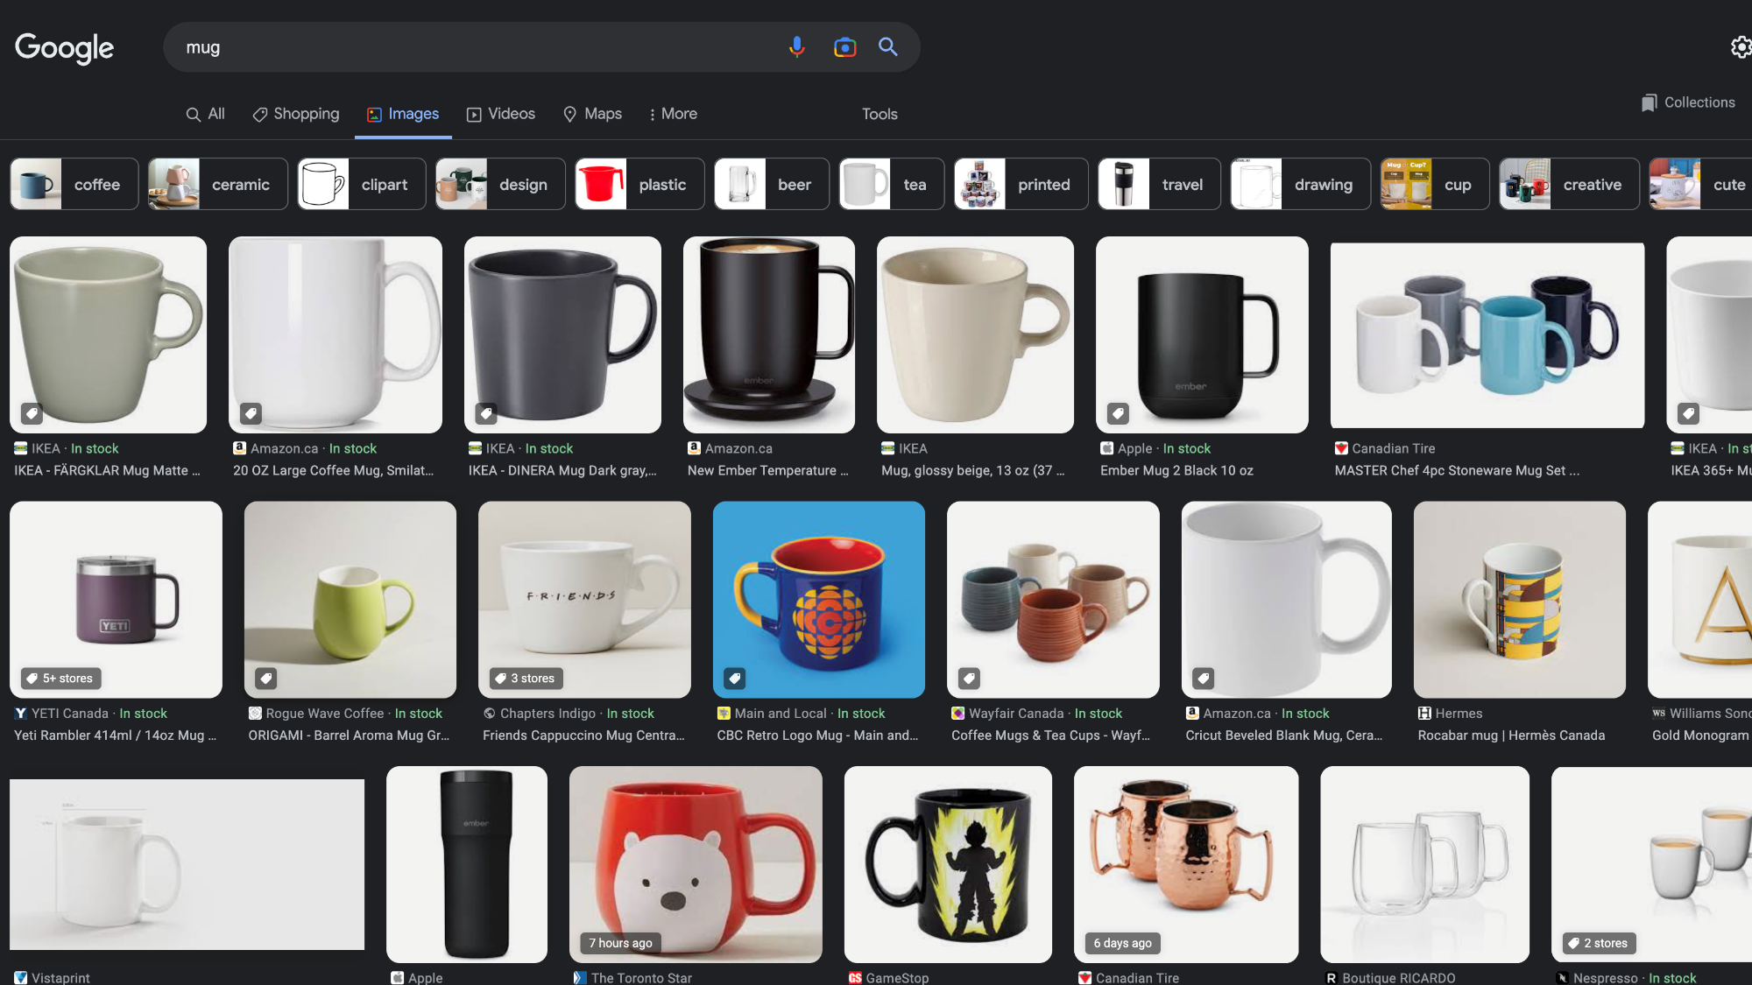
Notes:
Can you notice the “bias” in this dataset?
All of the mugs have the handles on the right!
How could you mitigate bias in this dataset? Simple data augmentations/flipping cropping, etc. can be helpful

Slide 20
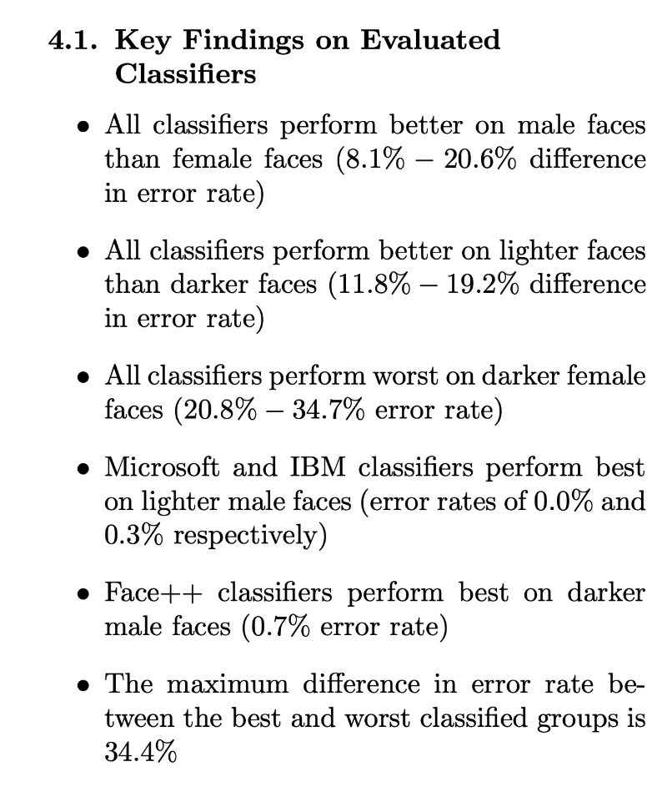
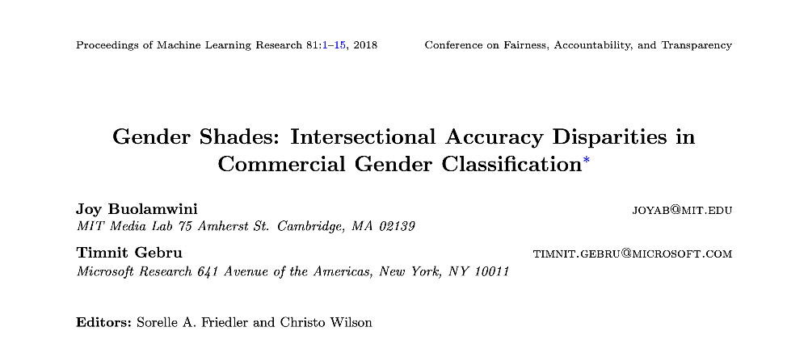
Notes:
one way to detect and mitigate bias is to create a smaller, unbiased dataset (using set classes and predetermined rules, e.g., Fitzpatrick Skin Type classification system)

Slide 21
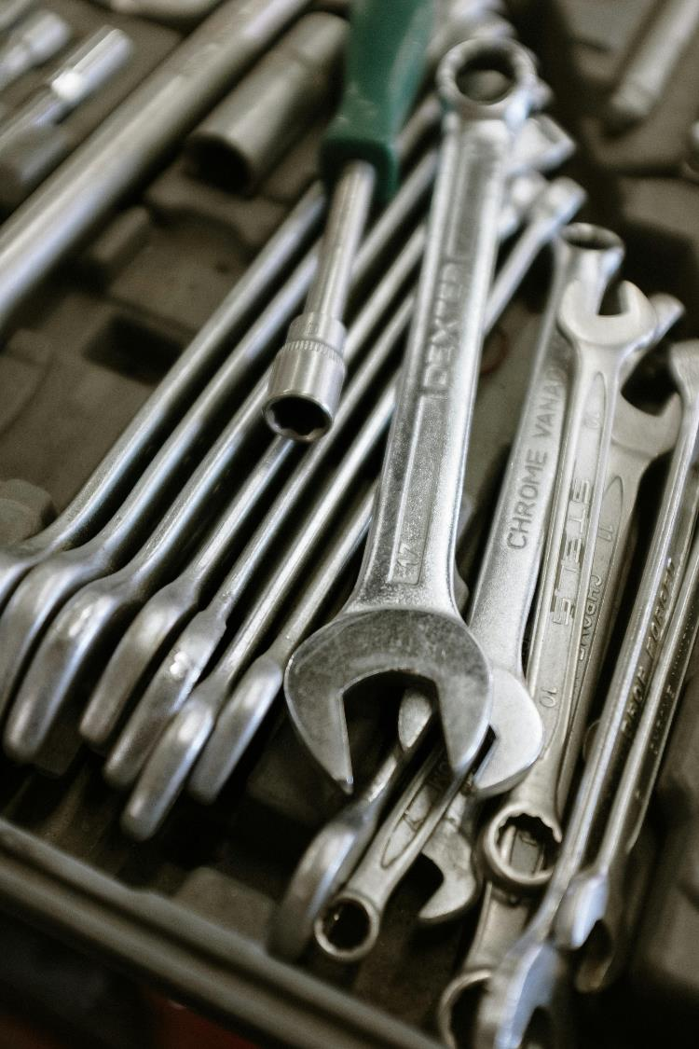
Other mitigation strategies
Train on balanced dataset, finetune on biased dataset to reduce chances of overfitting
Notes:
Photo by cottonbro studio: https://www.pexels.com/photo/stainless-steel-combination-wrench-set-4480452/

Slide 22
Other mitigation strategies
Train on balanced dataset, finetune on biased dataset to reduce chances of overfitting
Leverage labeled and unlabeled data to reduce sampling bias, increase size of dataset
Notes:
Photo by cottonbro studio: https://www.pexels.com/photo/stainless-steel-combination-wrench-set-4480452/

Slide 23
Other mitigation strategies
Train on balanced dataset, finetune on biased dataset to reduce chances of overfitting
Leverage labeled and unlabeled data to reduce sampling bias, increase size of dataset
Data augmentation, re-balancing
Notes:
Photo by cottonbro studio: https://www.pexels.com/photo/stainless-steel-combination-wrench-set-4480452/

Slide 24
Other mitigation strategies
Train on balanced dataset, finetune on biased dataset to reduce chances of overfitting
Leverage labeled and unlabeled data to reduce sampling bias, increase size of dataset
Data augmentation, re-balancing
Evaluate on multiple datasets, balanced test sets
Notes:
Photo by cottonbro studio: https://www.pexels.com/photo/stainless-steel-combination-wrench-set-4480452/

Slide 25
Other mitigation strategies
Train on balanced dataset, finetune on biased dataset to reduce chances of overfitting
Leverage labeled and unlabeled data to reduce sampling bias, increase size of dataset
Data augmentation, re-balancing
Evaluate on multiple datasets, balanced test sets
… (potentially many others!)
Notes:
Photo by cottonbro studio: https://www.pexels.com/photo/stainless-steel-combination-wrench-set-4480452/

Slide 26
Part 4:
Trade-offs in Bias
Notes:
Photo by Jens Johnsson: https://www.pexels.com/photo/brown-wooden-arrow-signed-66100/

Slide 27
Ideally we want an algorithm that is 100% accurate at classification, but this is seldom possible.
Our algorithms will make mistakes, but we have some choices about which and how many mistakes they will make.

Slide 28
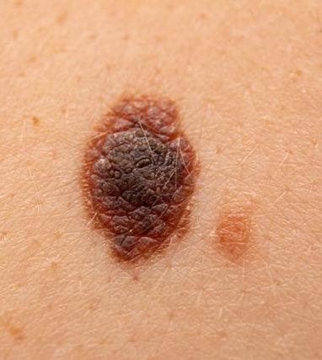
Our example: Mole classification algorithms
Notes:
We’ll focus on one use: determining whether a mole is cancerous or not. Dermatologists and oncologists often visually inspect moles before doing biopsies on them. They typically use their intuition – can it be done more quickly and accurately by AI? If so, that would be nice – would enable far more diagnoses, better cancer screening, etc. And the answer appears to be yes.

Slide 29
Mole Classifier:
Circles – cancerous
Squares – not cancerous
 | Correctly classified
Circles (cancerous) | /10
Squares (not cancerous) | /10
Total | /20

Slide 30
Worksheet
Please complete Part 1, Q1 of the worksheet.
You can complete this part individually.
Notes:
Photo by fauxels: https://www.pexels.com/photo/top-view-photo-of-people-having-a-meeting-3183165/

Slide 31
Sample classifier
Mole Classifier:
Circles – cancerous
Squares – not cancerous
Classification: Circle (cancerous)
 | Correctly classified
Circles (cancerous) | 7/10
Squares (not cancerous) | 7/10
Total | 14/20
Classification: Square
(not cancerous)

Slide 32
Trade-offs: Is overall accuracy always the most important thing to maximize in a classifier?
Notes:
One version of this: should we aim for datasets that are representative of demographics, or more diverse than demographics?

Slide 33
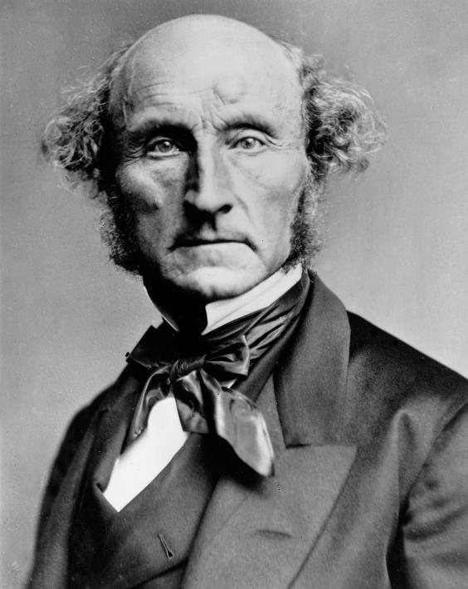
Philosopher John Stuart Mill’s utilitarianism:
An action is morally right when it maximizes good consequences (e.g. happiness) and minimizes bad consequences (e.g. pain)
Notes:
Image Source: Wikipedia (https://en.wikipedia.org/wiki/John_Stuart_Mill#/media/File:John_Stuart_Mill_by_London_Stereoscopic_Company,_c1870.jpg)

Slide 34
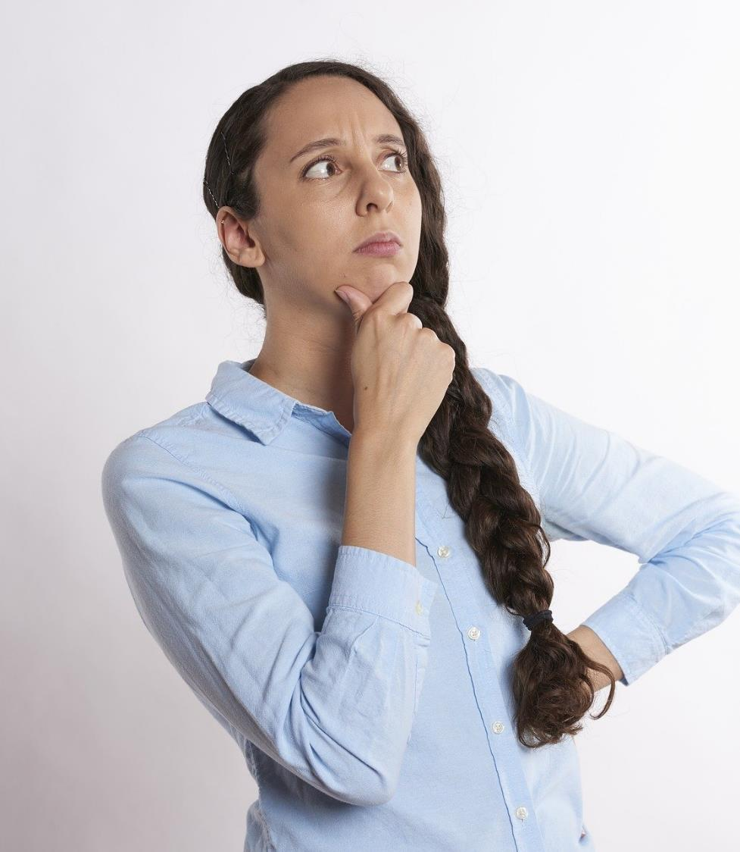
Discussion Question
Would a utilitarian agree that overall accuracy is the most important thing to maximize in a classifier?
Notes:
Background Image Source: Robin Higgins at pixabay (https://pixabay.com/photos/thinking-person-person-thinking-2681494/)

Slide 35
Sample classifier
Mole Classifier:
Circles – cancerous
Squares – not cancerous
Classification: Circle (cancerous)
 | Correctly classified
Circles (cancerous) | 7/10
Squares (not cancerous) | 7/10
Total | 14/20
Misclassifying a circle = false negative
Misclassifying a square =
false positive
Classification: Square
(not cancerous)

Slide 36
Sample classifier
Mole Classifier:
Circles – cancerous
Squares – not cancerous
Classification: Circle (cancerous)
These mistakes are worse!
 | Correctly classified
Circles (cancerous) | 7/10
Squares (not cancerous) | 7/10
Total | 14/20
Misclassifying a circle = false negative
Misclassifying a square =
false positive
Classification: Square
(not cancerous)

Slide 37
A utilitarian would say it is more important to minimize false negatives than false positives
Why?
more untreated cancerous moles ->
more people developing
cancer ->
less happiness and more pain
Notes:
Image Source: Wikipedia (https://en.wikipedia.org/wiki/John_Stuart_Mill#/media/File:John_Stuart_Mill_by_London_Stereoscopic_Company,_c1870.jpg)

Slide 38
Worksheet
Please complete Part 1, Q2 and Q3 of the worksheet.
You can complete this part individually.
Notes:
Photo by fauxels: https://www.pexels.com/photo/top-view-photo-of-people-having-a-meeting-3183165/

Slide 39
Mole Classifier:
Circles – cancerous
Squares – not cancerous
 | Correctly classified
Shaded (Subgroup 1) | /6
Circles (cancerous) | /3
Squares (not cancerous) | /3
Unshaded (Subgroup 2) | /14
Circles (cancerous) | /7
Squares (not cancerous) | /7
Total | /20

Slide 40
Sample classifier
Classification: Circle (cancerous)
Mole Classifier:
Circles – cancerous
Squares – not cancerous
 | Correctly classified
Shaded (Subgroup 1) | 1/6
Circles (cancerous) | 0/3
Squares (not cancerous) | 1/3
Unshaded (Subgroup 2) | 13/14
Circles (cancerous) | 7/7
Squares (not cancerous) | 6/7
Total | 14/20
Classification: Square
(not cancerous)

Slide 41
New classifier
Classification: Square
(not cancerous)
Mole Classifier:
Circles – cancerous
Squares – not cancerous
 | Correctly classified
Shaded (Subgroup 1) | 5/6
Circles (cancerous) | 3/3
Squares (not cancerous) | 2/3
Unshaded (Subgroup 2) | 1/14
Circles (cancerous) | 0/7
Squares (not cancerous) | 1/7
Total | 6/20
Classification: Circle (cancerous)

Slide 42
So far:
Often if we prioritize overall accuracy, some subgroups may be disproportionately affected.
If we try to prioritize the accuracy of those subgroups, often overall accuracy may be compromised.
How should we deal with this trade-off when our classifiers affect actual subgroups of people?
Notes:
One version of this: should we aim for datasets that are representative of demographics, or more diverse than demographics?

Slide 43
Classification: Circle (cancerous)
Mole Classifier:
Circles – cancerous
Squares – not cancerous
 | Correctly classified
Shaded (People with freckles) | 1/6
Circles (cancerous) | 0/3
Squares (not cancerous) | 1/3
Unshaded (People without freckles) | 13/14
Circles (cancerous) | 7/7
Squares (not cancerous) | 6/7
Total | 14/20
Classification: Square
(not cancerous)

Slide 44
Classification: Circle (cancerous)
Mole Classifier:
Circles – cancerous
Squares – not cancerous
 | Correctly classified
Shaded (Elderly people) | 1/6
Circles (cancerous) | 0/3
Squares (not cancerous) | 1/3
Unshaded (Young people) | 13/14
Circles (cancerous) | 7/7
Squares (not cancerous) | 6/7
Total | 14/20
Classification: Square
(not cancerous)

Slide 45
Worksheet
Please look at Part 2 of the worksheet and discuss the questions in small groups.
Notes:
Photo by fauxels: https://www.pexels.com/photo/top-view-photo-of-people-having-a-meeting-3183165/

Slide 46
Discussion Question
What would a utilitarian say about a classifier that performs better for some groups and worse for other subgroups?
Notes:
Background Image Source: Robin Higgins at pixabay (https://pixabay.com/photos/thinking-person-person-thinking-2681494/)

Slide 47
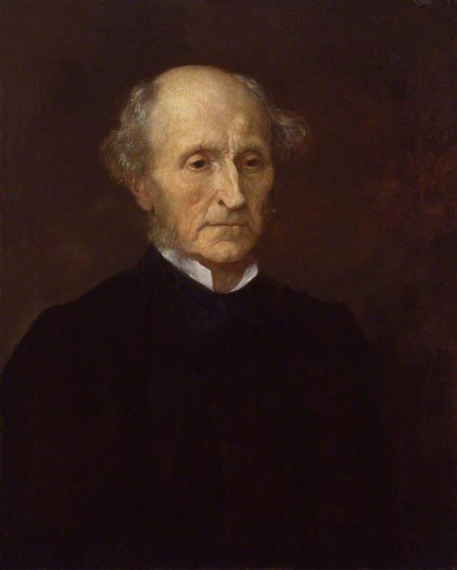
Sometimes you need to take into account subgroups in order to achieve the greatest happiness and least harm.
A utilitarian could argue people from some subgroups are more vulnerable to harms from misdiagnoses.
Notes:
Image Source: Wikipedia (https://en.wikipedia.org/wiki/John_Stuart_Mill#/media/File:Stuart_Mill_G_F_Watts.jpg)

Slide 48
Discussion Question
Of the subgroups you considered in part 2, are any of them more vulnerable to harms from misdiagnoses?
Notes:
Background Image Source: Robin Higgins at pixabay (https://pixabay.com/photos/thinking-person-person-thinking-2681494/)

Slide 49
Non-Utilitarian Reasons to Prioritize Subgroup Accuracy:
1. Have some subgroups suffered more harms already (so it would be unfair to give them more harms)?

Slide 50
Discussion Question
Of the subgroups you considered in part 2, would it be unfair for any of them to take on added risk?
Notes:
Background Image Source: Robin Higgins at pixabay (https://pixabay.com/photos/thinking-person-person-thinking-2681494/)

Slide 51
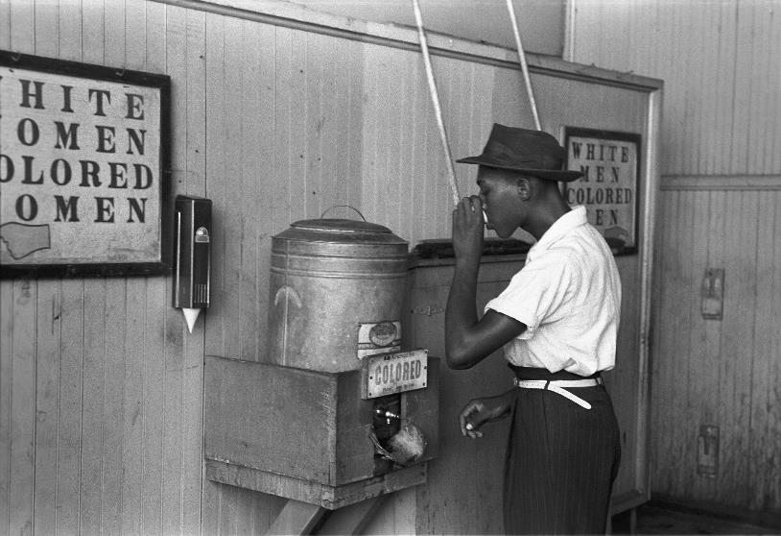
Other Possible Reasons to Prioritize Subgroup Accuracy:
2. Is the algorithm discriminatory towards subgroups?
Notes:
Image Source: https://en.wikipedia.org/wiki/Discrimination#/media/File:%22Colored%22_drinking_fountain_from_mid-20th_century_with_african-american_drinking.jpg

Slide 52
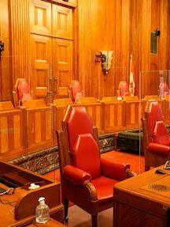
“Discrimination is a distinction which, whether intentional or not but based on grounds relating to personal characteristics of the individual or group, has an effect which imposes disadvantages not imposed upon others or which withholds or limits access to advantages available to other members of society.”
Supreme Court of Canada, Andrews v. Law Society of British Columbia (1989)
Notes:
We use “discrimination” several different ways in the English language – e.g. for fine taste
Image source: https://www.scc-csc.ca/home-accueil/index-eng.aspx

Slide 53
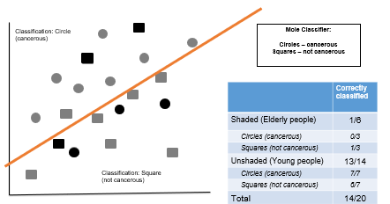
Two Challenges for Theories of Discrimination:
1. How do we distinguish discrimination from ordinary misclassification?
2. What makes discrimination worse than ordinary misclassification?

Slide 54
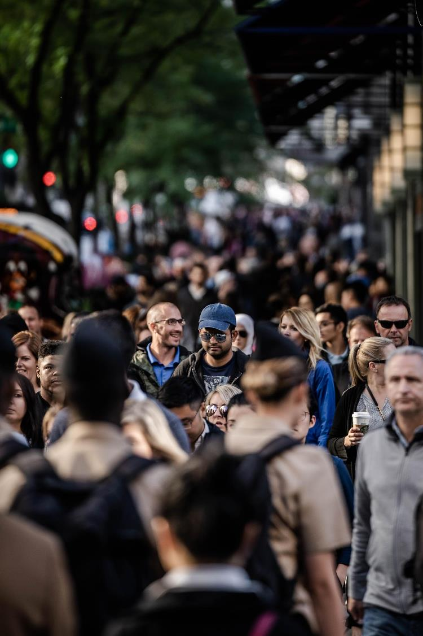
Some of the standard personal characteristics involved in discrimination:
Gender identity
Race
Sexuality
Disability
Age
(In Canadian Law, these are called “enumerated grounds”.)
Notes:
Photo by Cameron Casey: https://www.pexels.com/photo/people-on-sidewalk-selective-focal-photo-1687093/

Slide 55
To understand when an algorithm is wrongfully discriminatory, we need to think about why discrimination is particularly wrong.
Philosophers actually have big disagreements about this! But here are some of their theories…
Notes:
Photo by Cameron Casey: https://www.pexels.com/photo/people-on-sidewalk-selective-focal-photo-1687093/

Slide 56
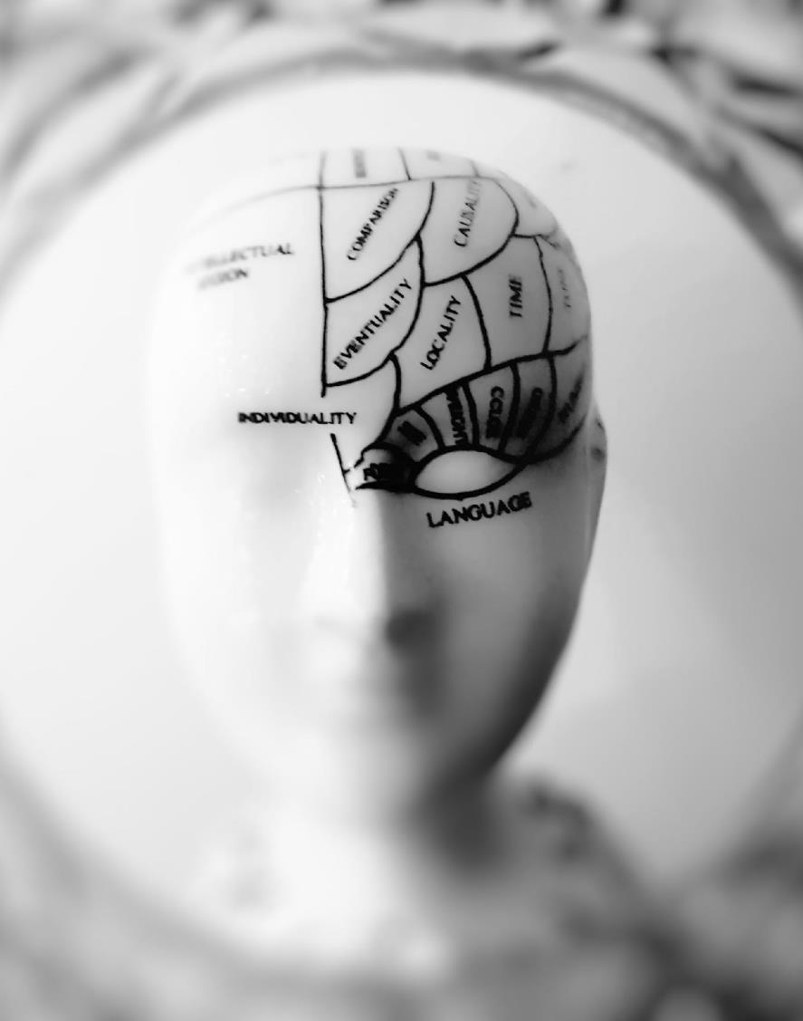
Irrationality: Discrimination is wrong because it involves treating someone arbitrarily or “without rational justification”. (Cotter 2006, 10)
Notes:
Photo by meo: https://www.pexels.com/photo/photo-of-head-bust-print-artwork-724994/

Slide 57
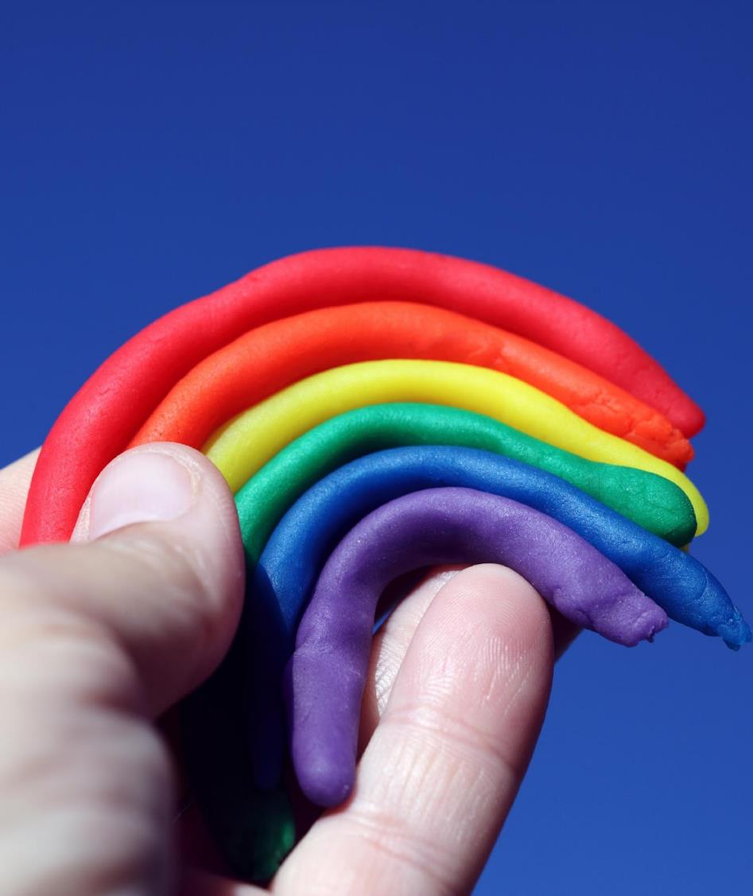
Immutability: Discrimination is wrong because it treats someone differently on the basis of an immutable trait, which is a trait that is “so central to a person’s identity that it would be abhorrent for government to penalize a person for refusing to change them, regardless of how easy that change might be physically” (Clarke 2015: 1)
Notes:
https://www.yalelawjournal.org/article/against-immutability
Photo by Alexander Grey: https://www.pexels.com/photo/rainbow-clay-1452797/

Slide 58
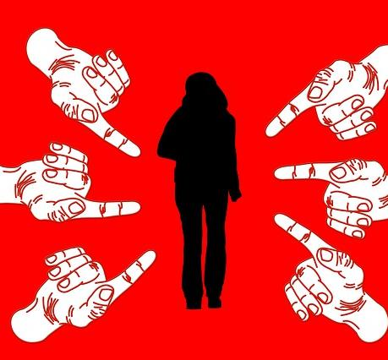
Demeaning: Discrimination is wrong because it involves demeaning another person, or expressing that that person has lower moral status because they belong to some group (Hellman 2018: 102)
Notes:
Image by Gerd Altmann from Pixabay (https://pixabay.com/illustrations/woman-bullying-stress-finger-3089939/)

Slide 59
It is very clear how all three criteria are met in segregation.
Notes:
Image Source: https://en.wikipedia.org/wiki/Discrimination#/media/File:%22Colored%22_drinking_fountain_from_mid-20th_century_with_african-american_drinking.jpg

Slide 60
It is clear how all three criteria are met in this case as well.
Notes:
Headline from Vox Media: https://www.vox.com/the-goods/2019/4/17/18412450/tsa-airport-full-body-scanners-racist

Slide 61
Discussion Question
Do any of these considerations {irrationality, immutability, demeaningness} apply when someone’s mole is misdiagnosed because they…
Have freckles?
Are elderly?
Have dark skin?
Notes:
Background Image Source: Robin Higgins at pixabay (https://pixabay.com/photos/thinking-person-person-thinking-2681494/)

Slide 62
Summary
Notes:
Photo by Jens Johnsson: https://www.pexels.com/photo/brown-wooden-arrow-signed-66100/

Slide 63
There are many sources of bias in image processing and image understanding algorithms: in the datasets and in the algorithms themselves
Not every dataset is appropriate for every application.
By being aware of the potential for bias, we can take some concrete steps to mitigate it.
Sometimes there may be trade-offs between overall accuracy and subgroup accuracy, and we need to think carefully in these cases about what to prioritize.

Slide 64
Acknowledgements
This module was created as part of an Embedded Ethics Education Initiative (E3I), a joint project between the Department of Computer Science¹ and the Schwartz Reisman Institute for Technology and Society², University of Toronto.
Instructional Team:
Philosophy: Steven Coyne
Computer Science: Babak Taati, David Lindell
Faculty Advisors:
Diane Horton¹, David Liu¹, and Sheila McIlraith^{1,2}
Department of Computer Science
Schwartz Reisman Institute for Technology and Society
University of Toronto

Slide 65
References
Altman, Andrew, "Discrimination", The Stanford Encyclopedia of Philosophy (Winter 2020 Edition), Edward N. Zalta (ed.), URL = <https://plato.stanford.edu/archives/win2020/entries/discrimination/>.
Clarke, Jessica A. 2015. “Against Immutability,” Yale Law Journal 125(1): 2-102.
Cotter, Anne-Marie Mooney, 2006. Race Matters: An International Legal Analysis of Race Discrimination. London: Routledge
Government of Canada, “C-27”, URL=< https://www.parl.ca/DocumentViewer/en/44-1/bill/C-27/first-reading>
Hellman, Deborah. 2018. “Discrimination and Social Meaning,” in The Routledge Handbook of the Ethics of Discrimination (ed. Kasper Lippert-Rasmussen). London: Routledge
The Verge. 2021. “Black Teen barred from skating rink by inaccurate facial recognition,” URL=<https://www.theverge.com/2021/7/15/22578801/black-teen-skating-rink-inaccurate-facial-recognition>.

